Slide 1
Dorothy House Hospice Care
“A Society Where Death Is A Part of Life…”
Dominic Denny | Community Bereavement Support Coordinator
Karen Gough | Welfare Rights Advisor
Carer’s Rights Day Expo: Tuesday 21st November 2023

Slide 2
Agenda…
Introductions
Vision, Mission, History of Dorothy House…
Who do we serve ?
Community is the future
Pre-bereavement
Last 1000 days (conceptual discussion)
Support when a serious illness arrives…
Dealing with bereavement, loss, grief…
Life after caring…
Q&A

Slide 3
Title goes here Subtitle goes here
Speaker Name goes here

Slide 4
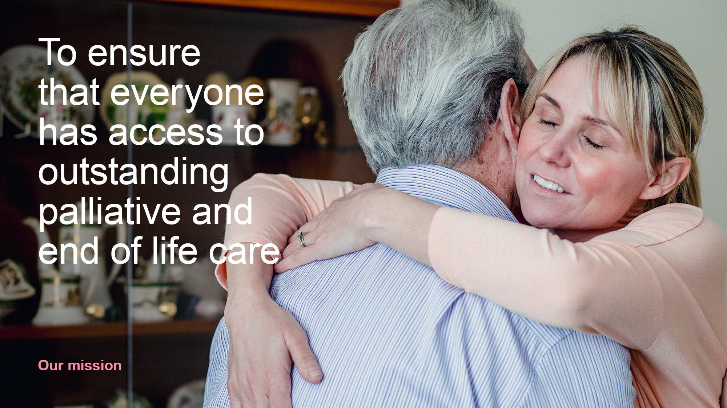
Headline
Short amount of introductory copy goes here around twenty to thirty words long on blue background volupta dolupt iunt diorectior autlam sust occum qui consedi piciam lau

Slide 5
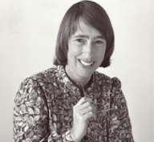
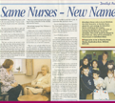
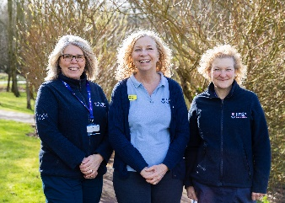
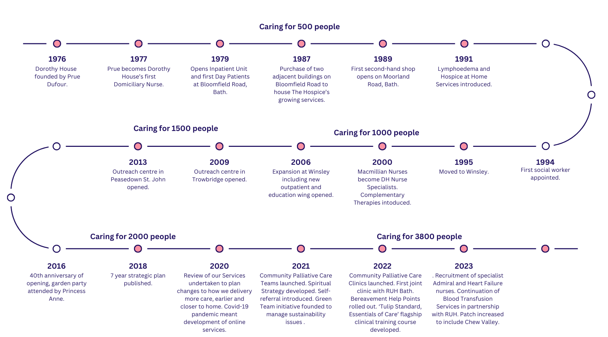
Our history
Constantly evolving to meet the needs of our community

Slide 6
Our key aims…
Care for more people
Local care, closer to home
Earlier support, through a person’s last 1,000 days
Easy access for everyone with a life-limiting illness using a simple referral process
Compassionate communities, developing partnerships and volunteering

Slide 7
Care for more people…
Dorothy House now supports over 3,700 people a year. These are referred patients and their families/carers or people supported through Dorothy House open access services, where a referral is not required.
Dorothy House tends to have around 900 referred people in its care at any one time – patients, their families and carers.

Slide 8
Local care, closer to home…
Dorothy House covers an area of approx. 700sq miles with a population of around 550,000 across Bath & North East Somerset (B&NES) and parts of Wiltshire and Somerset.
We estimate that we are currently caring directly for just over half of the people (approx 3,000 patients) in our area with a palliative care need.
In partnership with our community and in line with our mission, we want to ensure that palliative and end of life care needs are met in our area.

Slide 9
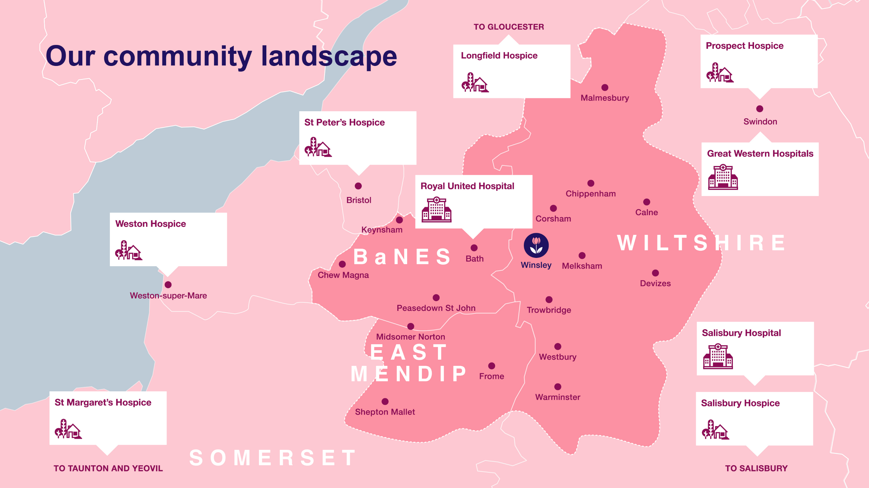

Slide 10
Easy access for everyone with a life-limiting illness using a simple referral process…
30% of Dorothy House patients cared for do not have a cancer diagnosis.
Life-limiting illnesses other than cancer include lung disease, heart failure, Motor Neurone Disease and dementia…
Prospective patients can now self-refer or someone can be referred by family or a friend…
No longer need to go via your GP.
Anyone can now access the 24hr advice line on 0345 0130 555
We also have an online Information Hub on our website with loads of resources including downloadable information sheets.

Slide 12
Compassionate communities, developing partnerships and volunteering…
Open Access Community Groups: 6 Bereavement Help Points, Walking through Grief, Writing Hour, Coffee Connections, By Your Side, Allotments Group.
Over 1,000 volunteers support the work of Dorothy House across our 700sq miles, serving a population of around 550,000 across Bath & North East Somerset (B&NES) including parts of Wiltshire and Somerset.

Slide 13
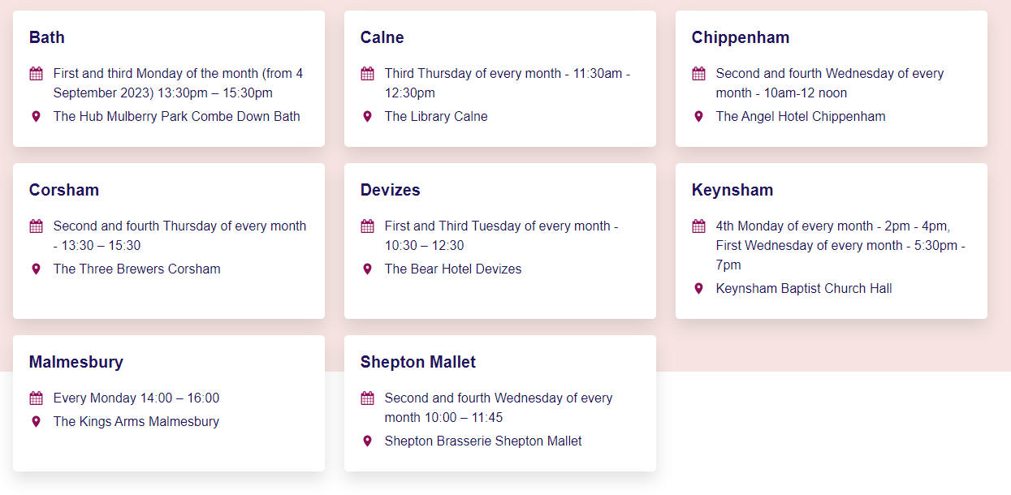

Slide 14
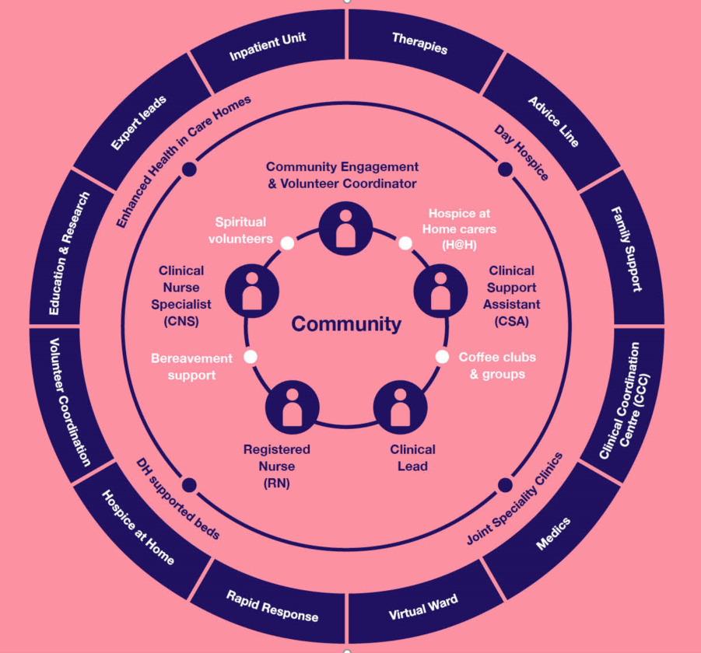
Asset Based Community Development (ABCD Model)

Slide 15
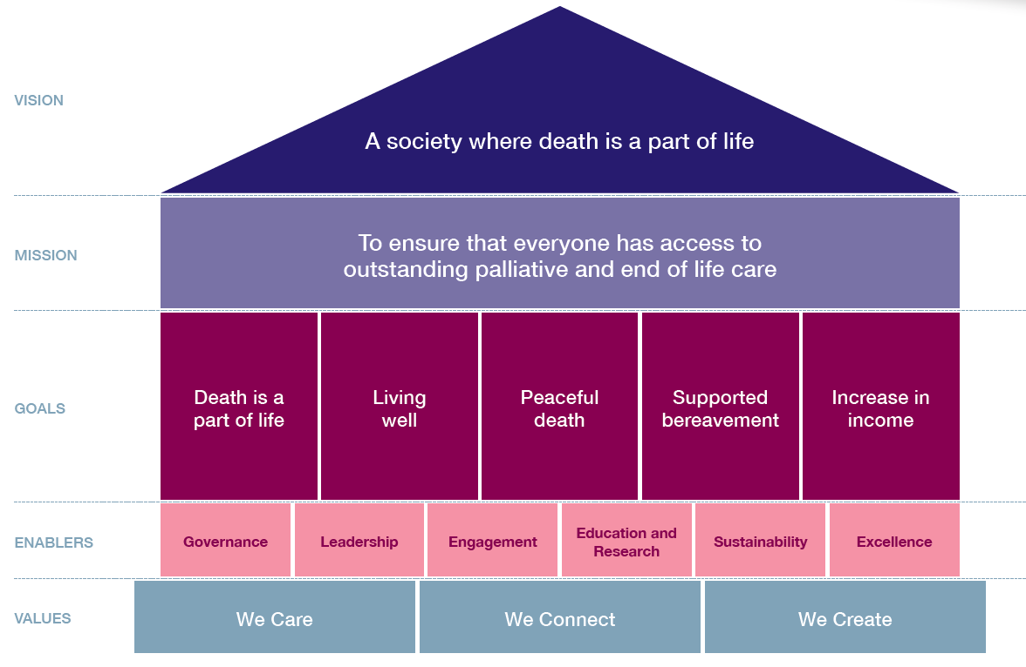

Slide 16
Anticipatory Grief : (Pre-Bereavement)…
Anticipatory grief is a feeling of loss before someone dies. You might feel it if your friend or relative has dementia, cancer, or another illness which you know will lead to their death.
The crisis of a palliative or terminal diagnosis can unearth buried issues, exacerbate existing family tensions and lead people to question everything about themselves, their lives and their relationships. Families have to weather this storm together, yet at the same time every individual faces their own emotional journey and can find themselves grappling with bewildering feelings of guilt, anger, fear and loneliness.

Slide 17
Anticipatory Grief : (Pre-Bereavement)…
Anxiety
Anger
Loneliness
Guilt
Exhaustion
Anticipation
Physical Effects
Allow yourself to grieve
Write down your thoughts and feelings
Look for support online
Learn more about their condition
Take care of yourself
Be kind to yourself
Remember you can do this
Take it a day at a time

Slide 18
Support when a serious illness arrives…the hard conversations.
Karen Gough, Welfare Rights Advisor

Slide 19
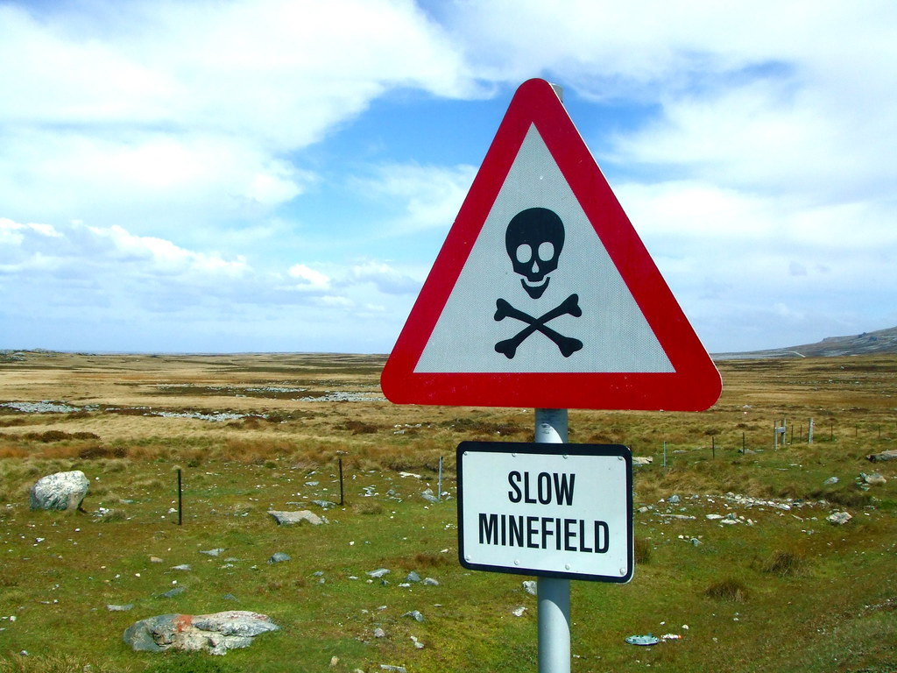
Today we will cover…
What are the different types of benefits ?
How to access help…
Getting your house in order …

Slide 20
Types of benefits
GROUP 1
NON-MEANS TESTED
AA?DLA?PIP
Can only have one of these
GROUP 2
MEANS TESTED
Universal Credit
Pension Credit
Council tax support
Housing benefit
GROUP 3
CONTRIBUTION BASED
SRP
SSP
ESA
BSP

Slide 21
Other support – What else is out there?
Council tax discounts & exemptions
Not means tested
Local welfare support schemes from the council
Your local CitA
Grants dependent on your illness/occupation/where you live
Help with the costs of bereavement
Funeral grant
BSP
Grant
VAT Exemptions etc.

Slide 22
How do I access help…?
Local CitA
Age Concern
Dorothy House Welfare Rights Team
Carers Centre
Don't ask the Job Centre
OR rely on your local council…

Slide 23
Getting your house in order ? Get a benefit check…
If you are a home owner have you made a will?
If you have a will does it need updating?
What is a POA? Do I need one?
Can I protect my home from being used to pay my care home fees?
What happens when my loved one needs to move into a care home?
Can I access my partners bank account?
Do we need to get married?
Pensions and life insurance.

Slide 24
Stephen Levine poet, author, teacher…
Loss is the absence of something we were once attached to. Grief is the rope burns left behind, when that which is held is pulled beyond our grasp.”*
*Unattended Sorrow - Stephen Levine: Rodale 2005. p.9

Slide 25
‘The Grieving Process: Coping with death…’

Slide 26
‘Stages of Grief’ ? Elizabeth Kubler-Ross (1969)

Slide 27
Phases, NOT ‘Stages’ of Grief
Acute Grief (grief experienced shortly after the loss):
The early response to loss that can be intense and all-encompassing, it can involve intense daily yearning to be reunited with the lost loved one, significant emotional pain, as well as a multitude of physical reactions that many may never have been felt before (e.g. heart palpitations, butterflies in the stomach, frequent yawning, dizziness/fogginess), feelings of unreality.
Frequently distracting thoughts of the deceased, trouble focusing attention, and forgetfulness. These are all normal adaptive reactions within the context of grief.

Slide 28
Phases, NOT ‘Stages’ of Grief
Integrated Grief:
The enduring residual form of grief in which the reality and meaning of the death are gradually understood and the bereaved are able to embark once again on pleasurable and satisfying relationships and activities.
Integrated grief does not mean that individuals forget their loved one, miss them any less or stop feeling sadness when thinking about them. The loss becomes integrated into the autobiographical memory system meaning that thoughts or memories of the deceased are no longer as preoccupying or disabling.
However, there may be periods when the acute grief re-emerges, this is common and does not reflect a failure or malfunction of the grieving process. This can occur around the time of significant events, such as holidays, birthdays, anniversaries, another loss, or a particularly stressful time.

Slide 29
Phases, NOT ‘Stages’ of Grief
Complicated grief:
A lasting form of acute grief with complicating features that impede the restructuring process necessary for integrated grief.
The term complicated is used because grief is thought to be a natural healing process and like the bodies other healing processes, there can be complications that mean it is not completed as intended.
Complicated grief is very similar to acute grief however it can go on for years without the intensity of the experience decreasing.

Slide 30
Dr Susan Delaney: ‘ What to say to a bereaved person…’

Slide 31
Reclaiming life after years of caring…
I Don't Know Who I Am Anymore: Grief and Loss of Identity
When your responsibilities as a carer come their natural end, one can often be left with a sense of ‘what now ?’
Everything has changed. Nothing is the same…
As one moves from a state of acute to integrated grief, carers often find themselves confused or a little lost. It’s normal…
The realisation that you are not the same person you were when you began caring for the one you have lost can have one questioning their identity and purpose.

Slide 32
Who am I ? : Caring and my identity…

Slide 33
Reclaiming life after years of caring…
Embrace Grief
Grief can be particularly complicated for long-term carers. It is not unusual for there to be a psychological tension between the profound sense of loss and the relief associated with the end of a life-limiting or terminal illness. Try to remain with the sadness, it is a process that everyone experiences differently.
Take Time
The first year is always the hardest, because it is full of ‘firsts’. Birthday, anniversaries, holidays, music, songs, smells… we don’t ‘get over’ loss. We learn to live alongside it in such a way that it does not distress us as much as it did. It’s your journey…there is no blueprint, right or wrong way to grieve. Take as long as you need…

Slide 34
Reclaiming life after years of caring…
Lean on Strengths
Everyone deals with loss differently, but the skills developed as a carer can help. Your loved one's death doesn't end who you are. You're still caring, loyal, committed, strong, persistent, resourceful, tenacious, smart, courageous, fun and funny. And those aspects will stick with you as time moves on.
Seek Support
It’s ok not to be ok. If you find your grief is overwhelming or unmanageable, reach out. Speak to a someone you trust whether family, friend, GP or specialist bereavement support. Dorothy House runs Bereavement Help Points across our footprint. These provide a ‘light touch’ social group of people all experiencing loss.

Slide 35
Reclaiming life after years of caring…
Become A Volunteer
Many carers go on to become volunteers. Apart from the value to whichever organisation you volunteer for, the experience can provide huge benefits in terms of the progression of your journey with grief. Bringing skills, experience, resilience and another perspective can help build self-confidence, sense of identity as well as providing a network of friends and an added layer in your community.
Be Gentle and Compassionate with yourself
Make yourself and your needs the priority. Remember that the basics like diet, exercise, sleep are all essential parts of self-care that will help take the edge off your feelings.

Slide 36
Dorothy House Hospice Care
Q & A
Dominic Denny | Community Bereavement Support Coordinator
Karen Gough | Welfare Rights Advisor
Carer Support Wiltshire: Tuesday 21st November 2023

Slide 37
Thank you…

