Slide 1
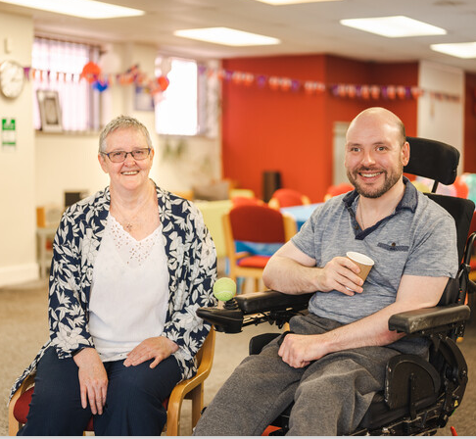
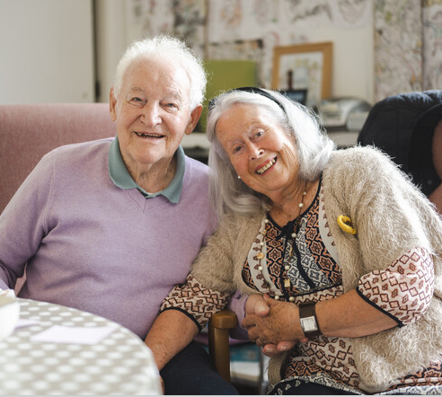
New to Caring
Sandra Parkin, Carer Support Wiltshire
Samantha Coggans, Carer Support Wiltshire

Slide 2
What is a carer
In the UK, 3 in 5 people will be unpaid carers for a family member or friend at some point
Notes:
Carers have no time limits when caring for others and may find the experience both positive and rewarding, but also exhausting, stressful, and isolating
Support is available for unpaid carers, and we are here to help

Slide 3
Tom’s story
A lot of people don’t actually realise they are carers until they’re called a carer. I think I was made aware of it at the doctor’s surgery. They brought along someone from Carer Support Wiltshire who explained what they did and I thought, gosh I’ve been doing this for a few years. They’re an organisation that can point you in the right direction for all sorts of help and gadgets and all sorts of things like that. I don’t think it crossed my mind really. It was just a fact of life. My wife became disabled with muscular dystrophy. It was a gradual process – it didn’t happen overnight. She lost the muscle power to do things like walking and lifting things like kettles – simple things like that. Then you suddenly realise that you’re doing these things. It creeps up on you, quietly, gradually.

Slide 4
Where to start
Notes:
If you are a carer over 16 years old, register with us and your GP surgery and seek available support
Plan for the future, including managing your loved one's health and financial affairs, exploring financial support for you, signing up for a Carers emergency card, and taking care of your own mental well-being

Slide 5
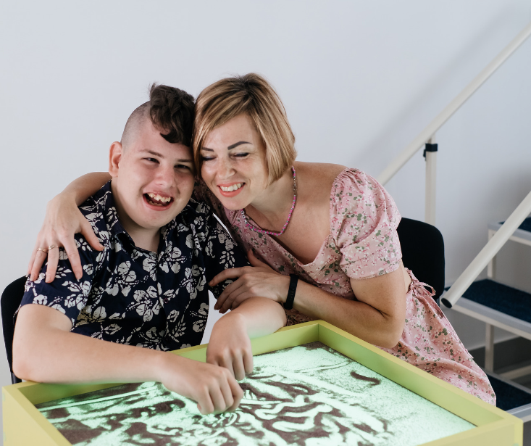
If you are caring for a child
Wiltshire Parent Carer Council can be contacted:
On 01225 764 647
By emailing admin@wiltspcc.co.uk
Notes:
At Carer Support Wiltshire we provide assistance to all carers, including parent carers
For parent carers, there is often a transition of realization that you are more than just a parent
If you look after a child under 18 with special educational needs and/or disability, speak to Wiltshire Parent Carer Council on 01225 764647 and they can provide support and information

Slide 6
If you are caring for an adult
Wiltshire Council’s Advice and Contact team can be contacted:
On 0300 456 0111
By emailing adviceandcontact@wiltshire.gov.uk
Or by completing an online referral form at https://adultslas.wiltshire.gov.uk/web/portal/pages/referrals/acreferral
Notes:
Majority of this presentation will focus on those caring for adults – however, the information can relate to all who are new to caring
Wiltshire Council's Advice and Contact team provides information and advice on available support for adults
They can also arrange a Care Act assessment to identify support services or equipment that could benefit both the caregiver and the person being cared for

Slide 7
Being a ‘carent’
Notes:
A 'carent' refers to individuals caring for both children and elderly parents, also known as Sandwich carers
These individuals face the challenge of balancing care for multiple family members, coping with the dual responsibilities, along with work commitments
According to Taking Care, one in three adults give up work to care for elderly parents
This prompts the question of whether there is a lack of support for such individuals

Slide 8
Accepting that your parents need care
Notes:
Watching elderly relatives lose their independence is difficult
Signs they may need extra care include:
Taking less care with their personal hygiene
Forgetting to take medications, eat meals, and pay their bills
Having reduced mobility and strength
Getting more easily confused or stressed
Having new injuries

Slide 9
How to offer them
support
Notes:
The first step is to talk to your elderly relatives with openness and respect about any concerns you have
This may be a difficult conversation, but it will help you take necessary steps to provide them with additional care
Consider the location and accommodation of your elderly relative, their long-term needs, and whether they require the assistance of healthcare workers for specific care requirements
Look for willing and able individuals in your surroundings who can help you care for them

Slide 10
How to care
Notes:
As a caregiver, prioritize the physical and emotional needs of those you care for while also taking care of yourself
Providing routine, emotional support, attending to physical needs and ensuring a strong quality of life are important
Caring for yourself can include finding time to relax, seeking support from others, or professional assistance if needed
Prioritizing self-care is necessary to provide the best possible care for others

Slide 11
Getting support
Notes:
Carers may be eligible for benefits such as Carers Allowance, if you care for at least 35 hours per week, but these are subject to individual circumstances
We recommend getting a benefits check done by a professional agency such as Wilts CA
Looking at flexible working options may be necessary
Contacting organizations such as Age UK, and Carers UK can provide further advice, support, and respite care
Contact us if you have any questions and we will do our best to help signpost and provide you with information

Slide 12
Checklist
Prioritize your well-being by getting a Carers Assessment (if eligible) and registering as a carer with your GP
Make time for your interests
Check available carer-related financial benefits and eligibility
Talk to your employer about your situation and the possibility of flexible work arrangements
Consider getting the person you care for a care needs assessment, doing a benefits check, making home adaptations, and planning for the future

Slide 13
Any Questions?

Slide 14
Thank you for attending

