Slide 1
Looking after you
Martina Gibson, Carer Support Wiltshire
Pippa Belsten, Wiltshire Council
Lise Griffiths, Wiltshire Council
Claire Springer, Olive Branch Counselling

Slide 3
What we do
The Health Coach service is provided by Wiltshire Council free of charge to anyone 18 or over living in Wiltshire.
We support people who want to make changes their lifestyle to support their physical and emotional wellbeing.
We work with people who want to lose weight and eat more healthily, do more physical activity, stop smoking, reduce their alcohol intake and improve their emotional wellbeing.
We offer 1 to 1 support and group sessions.

Slide 4
Mental Health as a Positive Concept
In a given year:
1 in 200
people will experience a severe and enduring mental illness.
1 in 6
people will experience a diagnosed period of mild or moderate mental illness.
But every day of every year:
100%
of us have thoughts and feelings.

Slide 5
Five Ways to Wellbeing

Slide 6
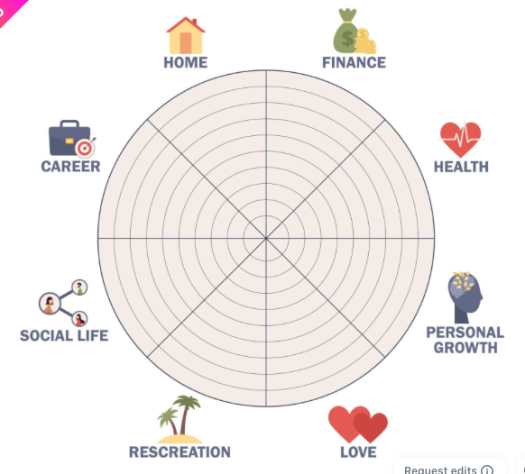
Wheel of life
Home
Finance
Career
Health
Social Life
Personal
growth
Recreation
Love

Slide 7
Living within the window of tolerance: the different zones of arousal
HYPERAROUSAL ZONE
Signs you are here
Sympathetic ”Fight or Flight” Response
(Too much arousal)
Signs you are here
OPTIMAL AROUSAL ZONE
Ventral Vagal “Window of Tolerance”
HYPOAROUSAL ZONE
Signs you are here
Parasympathetic ”Immobilisation” Response
(Too little arousal)

Slide 9
The Stress Bucket
This bucket represents our capacity to hold a certain amount of stress
Daily stresses fill up our bucket, so we therefore need to empty it out on a regular basis through stress-relieving activities.
We all hold different sized stress buckets
If we let our buckets overflow, this is when we start to feel emotional distress i.e. anxiety

Slide 10
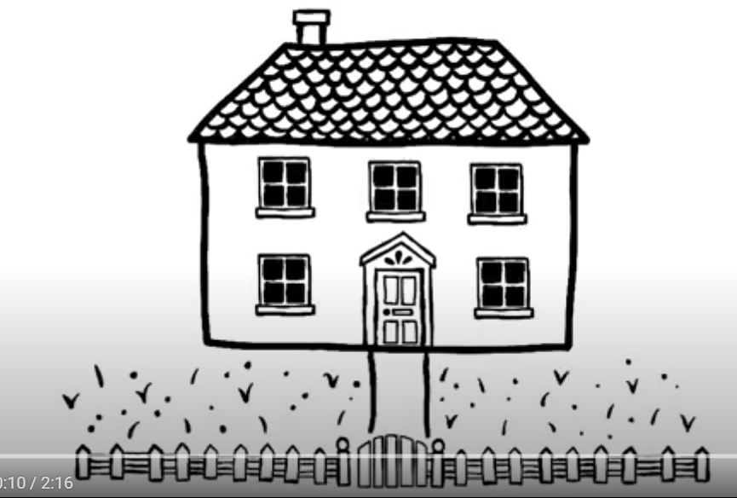
Problems and Worries
https://www.flickr.com/photos/186842236@N08/53313937373/
Notes:
Something that can help us to manage our wellbeing is trying to focus on what we can control. We’re going to show you a video now that explains what we mean by this and why it’s so helpful. https://www.flickr.com/photos/186842236@N08/53313937373/

Slide 11
Self-Care Checklist
Identify 3 things that keep you generally well
Identify 3 things to help you feel better right now
We tend to forget to do things for ourself that keep us well
Keeping ourself well means you can help other better and give more of your energy to them
Recognising what these things are that keep you generally well, will support your wellbeing overall and help deal with any stressor or anxieties you may have
When we feel overwhelmed we often forget the things that can keep us better in that moment
These are simple things you would be able to do right now to help calm you down and ‘press’ reset
Think of the things that has worked well for you in the past or possible ideas you could try when you are feeling overwhelmed to help calm you down

Slide 12
2 Different ways to help you support your own wellbeing and bring yourself back to the present moment.
You can do these at any time and anywhere
No one will even know that you are doing them
It can help calm and relax you down when things might be tense or stressful
It cannot fix the issues you are dealing with but it can support you for that moment

Slide 13
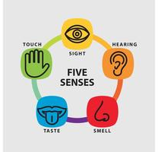
Five senses exercise
Focus on your breath, and one at a time, try to focus on:
5 things you can see
4 things you can feel
3 things you can hear
2 things you can smell
1 thing you can taste

Slide 14
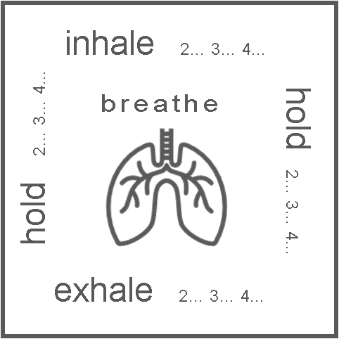
Squared Breathing Exercise
Focus on your breath
Pick how long you will count for (e.g. we are using 4 seconds)
Take a deep breath in for 4 seconds
Hold your breath for 4 seconds
Breathe out for 4 seconds
Hold you breath again for 4 seconds
You can repeat this however many time you would like.

Slide 15
Contact details
Wiltshire Council Health Coaches
health.coaches@wiltshire.gov.uk
0300 003 4566 (Select Option 1)
Olive Branch Counselling
counselling@olivebranch.charity
01249 554390

Slide 16
Any Questions?

