Slide 1
What you need to know about looking after a child with additional needs
Jo Hiller-Culley, Carer Support Wiltshire
Stuart Hall, Wiltshire Parent Carer Council

Slide 2
Jo Hiller-Culley - Carer Support Wiltshire
Family and Parent Carer worker since July 2023. Now working in the Young Carer team.
Worked supporting Parent Carers for over ten years. Various organisations.
New role, also encompasses all caring members of the family, which might include Young Carers and Young Adult carers.

Slide 3
Our support for parent carers and young carers
Approximately 3500 Parent Carers registered with Carer Support Wiltshire
Approximately 1200 Young Carers
Approximately 500 Young Adult Carers
Parent Carer Support
1:1 support conversation/Assessment of Need.
Two Parent Carer Support groups per month. Face-to-face and virtual evening group/ Family events (All welcome)
Regular information emails and signposting/ access to grants.

Slide 4
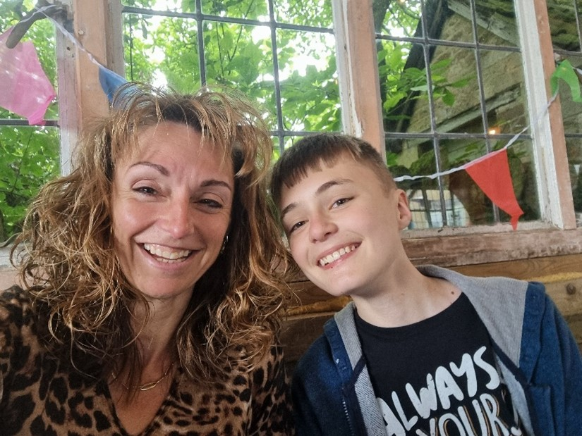
Young Carers (5-15) (Since April 2023)
1:1 support/ Support Plan
Holiday time activity program/YC magazine
1:1 support conversations in school, if extra
support required.
Young Carer School Accreditation scheme.
Young adult carers
Transition assessments (16+)
Continued 1:1 support, up to 25 years
YAC cafes
Further information on how to register, or if you would like to register any other members of your family, call us on: 0800 181 4118 or visit our website: www.carersupportwiltshire.co.uk

Slide 5
Wiltshire Parent Carer Council (WPCC)
www.wiltshireparentcarercouncil.co.uk
01225 764647

Slide 6
Notes:
When you realise you have a child with additional needs, it can be scary, isolating, confusing.
You might feel alone and possibly wonder where to go for information, advice, support, guidance or to connect with other people in a similar situation.
You might experience feelings of grief, loss and bereavement

Slide 7
Stages of Grief
Denial
Anger
Bargaining
Depression
Anxiety
Notes:
Classic stages of grief…
Denial
Anger
Bargaining
Depression
Anxiety

Slide 8
Some parent carers’ experiences
Suspicion
Confusion
Relief
Terrible Sadness
Coping/Not Coping
Trusting my Gut
Notes:
Some parent carers describe…
Suspicion
Confusion
Relief
Terrible Sadness
Coping/Not Coping
Trusting my Gut

Slide 9
Notes:
You are not alone…
My name is Stuart Hall
I am a parent carer
I have been in the same place as you
I am the Strategic Director of the Wiltshire Parent Carer Council – WPCC
I would like to tell you a little bit about what we do as a service and how we can help you to feel less alone, isolated and confused

Slide 10
Who we are
Notes:
Wiltshire’s Parent Carer Forum
Why and when established…

Slide 11
Our membership
Nearly 5,000 registered parent carers

Slide 12
Influence and Voice
Represent nearly 5,000 registered parent carers across Wiltshire (excluding Swindon)
Specialist Consultation and Participation Service
Shape and improve services - coproduction
Notes:
Consultations, engagement sessions, focus groups
Surveys, one to one conversations/interviews

Slide 13
Information
Notes:
Triage
SENDIS
Outreach
Local Offer
Family Hubs

Slide 14
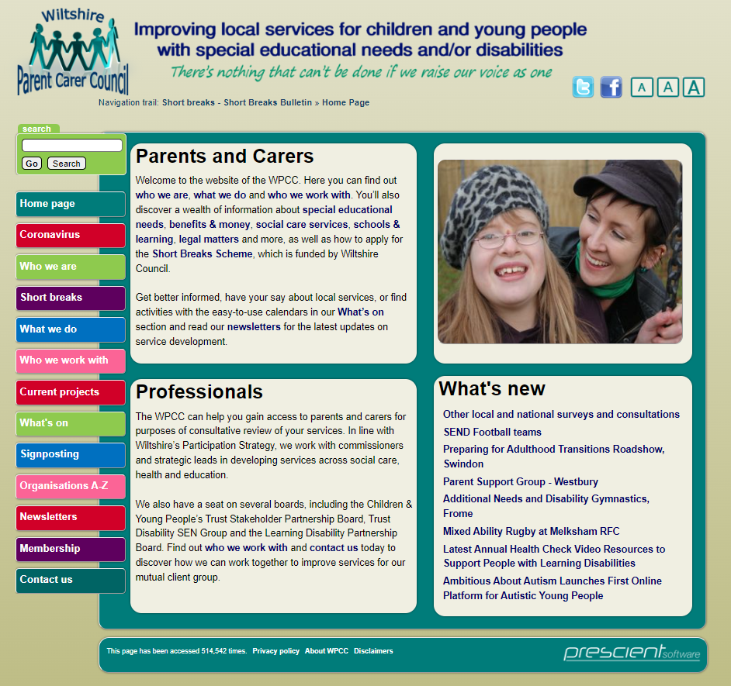
WPCC Website – Front Page

Slide 15
WPCC Website - Signposting

Slide 16
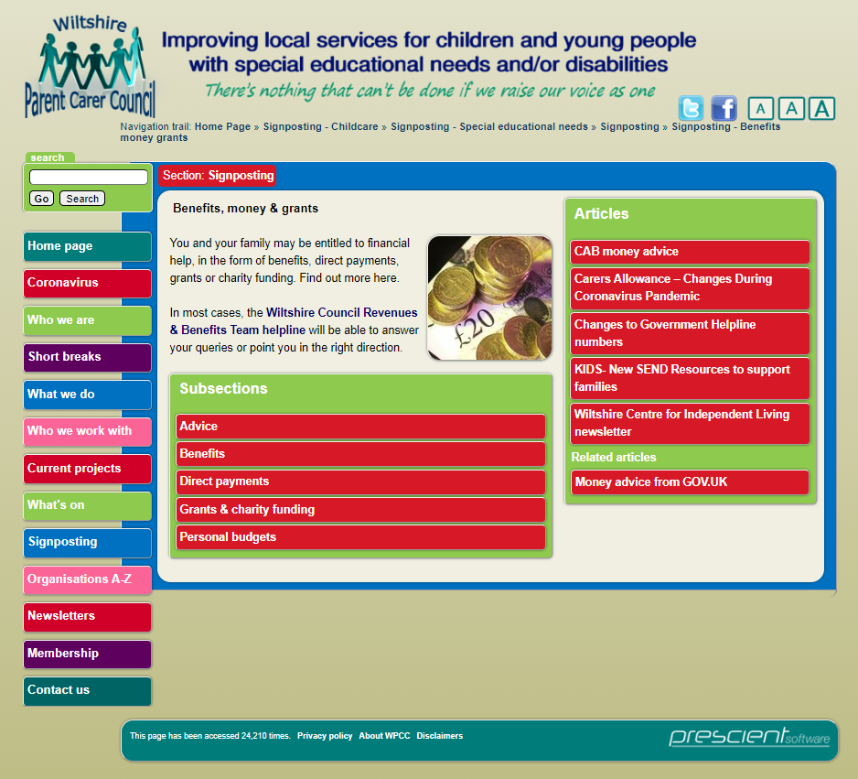

Slide 17
WPCC Website – What’s On

Slide 18
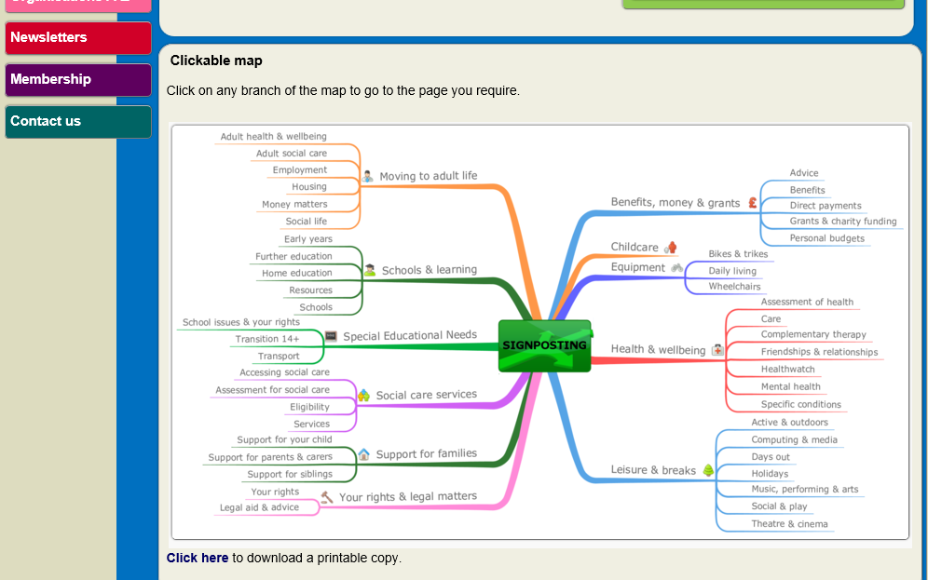

Slide 19
Communicating information
Notes:
Newsletters
Social Media
Events
Short Breaks Bulletins

Slide 20
Short Breaks Scheme

Slide 21
What else the WPCC Does
Time Out for Parents
DaD1

Slide 22
How to contact the WPCC
01225 764647
(10am to 5pm, Monday to Friday)
51 weeks a year
admin@wiltspcc.co.uk
www.wiltshireparentcarercouncil.co.uk

Slide 23
Any questions?

