Slide 1
In an emergency
Leanne Hubbard, Carer Support Wiltshire
Su Sealy, Carer Support Wiltshire
Lynda Ashman, Aid Training

Slide 2
Peace of mind
We’d advise all carers to create an emergency plan for you and those you look after
Can help ease worries if you are not able to look after those you care for at any point
We would also recommend signing up for a Carers Emergency Card
Keep it up to date
Notes:
As Carers we like to think that we will always be there when needed but sometimes this is not possible. This could be for many reasons, such as:
You may suddenly become unwell or be injured and be unable to carry out your usual caring role even if you are not in hospital.
Unplanned admission to hospital following an accident or a medical emergency
You may have a domestic emergency which must be dealt with (i.e. fire, flooding)
Family emergency, such as a relative or other dependent being taken ill or a death in the family
Risk to your employment on a particular occasion. For example, unexpected or unplanned changes to your usual work routine, such as a need to travel away from home/work base.
Breakdown of care arrangements
A Contingency Plan is there so that the person you are caring for is supported at the earliest opportunity and you have peace of mind that there is something in place.

Slide 3
Some tips for your plan
Contact details
Name, address and contact details of the person(s) you look after
Date of birth
Who you’d like to be contacted in an emergency
This might be family, friends or perhaps a neighbour
It might also be a professional such as your doctor
Any property key holders in case access to the property is needed
Notes:
When creating your plan we recommend you think about these things:

Slide 4
Some tips for your plan
Medical details
Conditions
Details of GP and pharmacy – yours and cared for’s
Details of any medication the person you look after is taking and where it can be found
Details of any ongoing treatment they need
Note if they have any allergies

Slide 5
Some tips for your plan
Support services & dependents
Any care and support services they receive
Any dependents the cared for has, and if they have a caring role
Any other dependents you have
Other needs
Communication, sight or hearing aids
Mobility aids

Slide 6
When you’re out and about
Carers Emergency Card
Free
Available to all carers aged 18 or over including parent carers.
Provides a 24/7 call centre contact number and a PIN.
Allows you to identify alternative carers who could provide emergency care.
Needs of the person you care for and their preferences for alternative care provision which can be accessed by health and care professionals who may need to be involved in making arrangements for alternative care.
Available as card and/or keyring fob

Slide 7
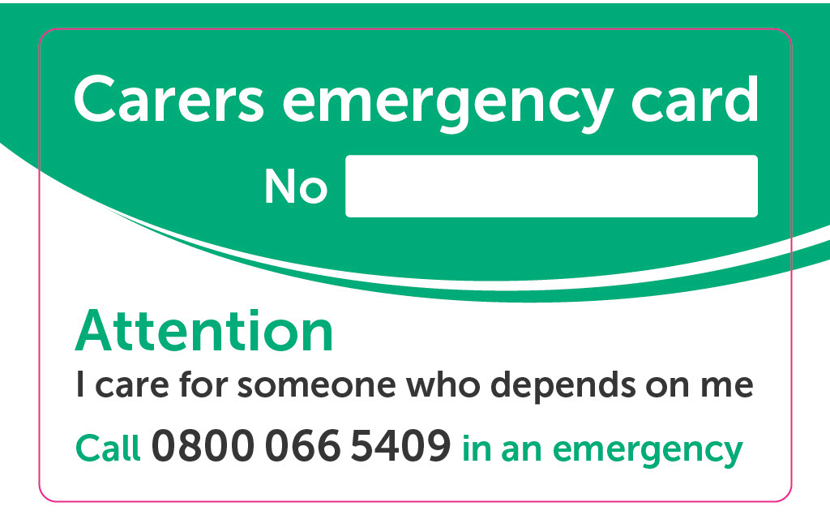
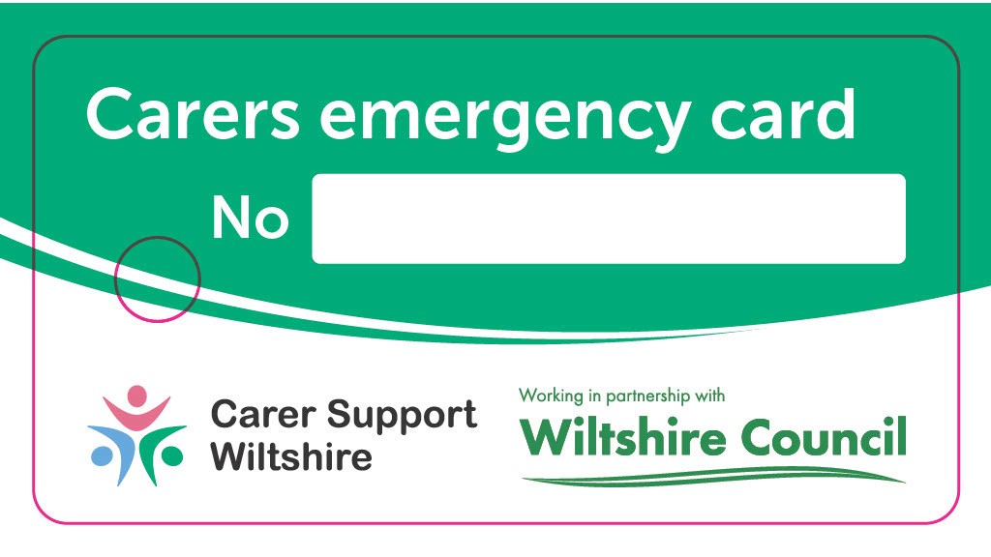
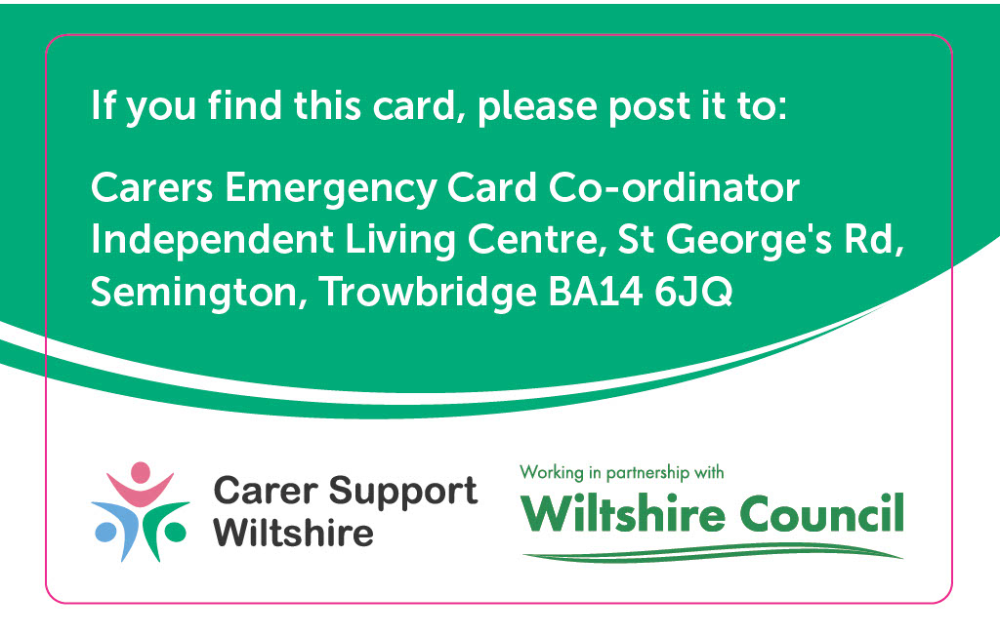
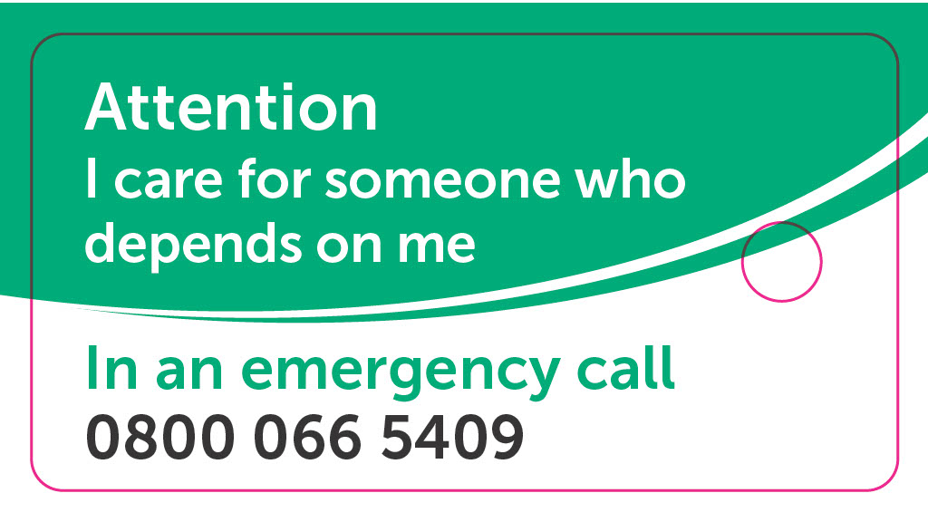
When you’re out and about
CEC Flexi tag/key fob
CEC card

Slide 8
Why now?
In an emergency situation there might not be much time so having this information quickly available will be extremely helpful
We’d recommend talking the plan through with the person you care for if possible
Discuss it with your named emergency contacts as well, explaining what this responsibility would mean
It’s also worth sharing with key family members and healthcare professionals.
Let people know where they can find it

Slide 9
Practical first aid session

