Slide 1
Building support around you
Debra Rist, Carer Support Wiltshire
Dee McFadden, Carer Support Wiltshire
Pete Twiggs, Wiltshire Council
Laura Roberts, Wiltshire Council

Slide 2
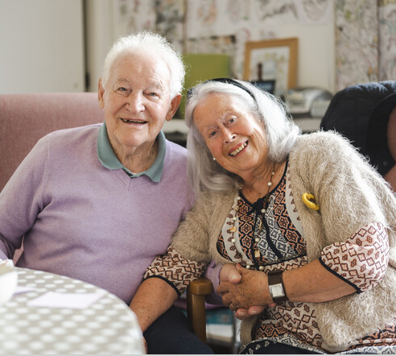
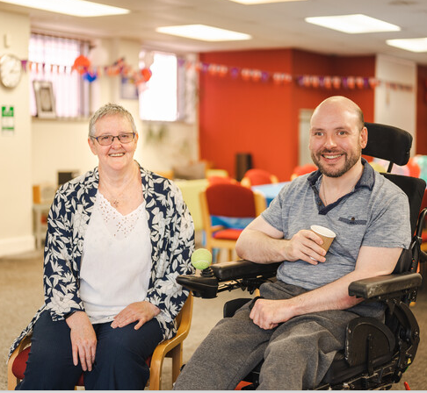
Let’s talk
What’s it like to be a carer?
What has helped you in your caring role?
What would good support look like?

Slide 3
Our starting point
How we work with unpaid carers
Person centred
Strength based
Holistic
Non judgemental
Empathy
Focus on what’s important to you
Networks of support on an individual basis and more widely
Co-production
Working partnership
Proportionate
Empowerment.
Prevention

Slide 4
The Carer Support Wiltshire carer casework team
An opportunity for you to discuss your caring role and any concerns that you may have
Advice, information, guidance
Signposts or referrals to appropriate organisations
Carer Support Wiltshire services
Support for the person you look after
Family/friends/neighbours/community support

Slide 5
The Carer Support Wiltshire support team
We will talk to you about
Support for the person you look after
Your existing support networks
Family/friends/neighbours
Community support – places of worship, clubs, groups etc
Primary and secondary care
Financial support – benefits etc

Slide 6
A Carers Assessment
If we feel that your caring role is having an impact on your health and wellbeing and your existing support isn’t enough, we will suggest you have a Carers Assessment
You can request a Carer Assessment at any time and they are governed by The Care Act 2014
Can be undertaken with you either by telephone, face to face at your home, a place that you prefer or by means of a “self-assessment” it really is your choice.

Slide 7
A Carers Assessment
The myths
It’s not a judgement on your caring abilities
You don't have to live with the person you care for
It doesn’t matter how many hours of care you provide
If you share the care with someone else, then you are both entitled to your own Carer's Assessment
What a carers assessment is
A conversation between yourself and a member of our team to discuss what care you are providing, how it affects you and what you would like to change.

Slide 8
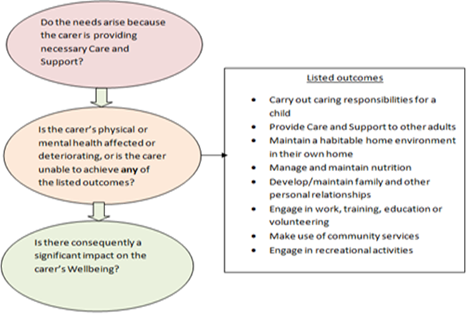
A Carers Assessment
Eligibility criteria

Slide 9
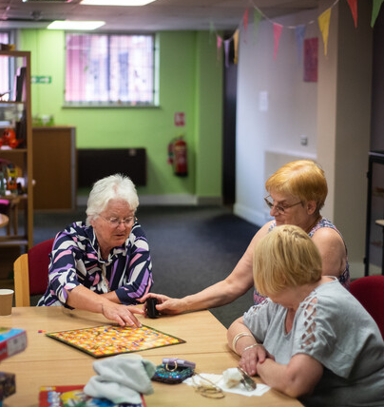
Possible carer assessment outcomes
Not always a paid service
Technology enabled care
Training
Mobility equipment & house adaptions
Community/peer support
Signposting & referrals
Carers Emergency Card
Paid service
Direct payments
Council commissioned service

Slide 10
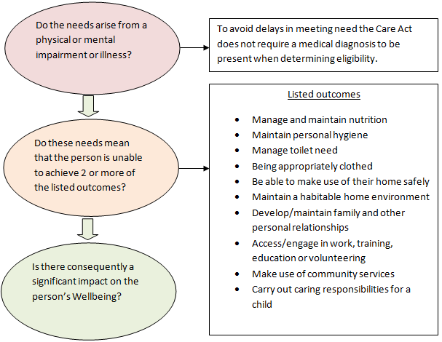
And for the person you care for
Care Act Assessment

Slide 11
Top tips
Do it before you need it
Be prepared
Describe your worst day
Review it – annually or earlier if circumstances change
Make a note of what’s agreed
Share any existing plans & support you have in place
How are you managing now and how might you in the future

Slide 12
Any Questions?

